Slide 1
Assignment1

Slide 2
Iperf TCP throughput
Observe and plot TCP throughput over the wired/wireless channel using different parameters of iPerf
Mb/s

Slide 3
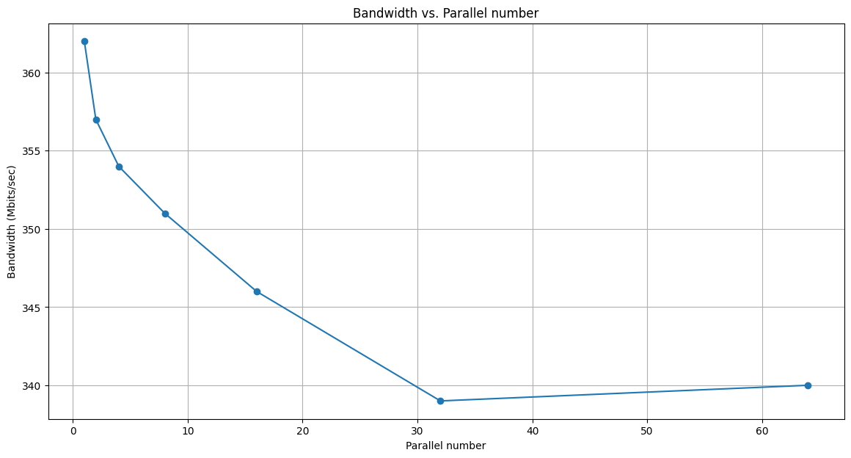
Parallel Connections
Parallel connection bandwidth is smaller than basic connections. More parallel cannot increase bandwidth in a wired environment.
Explain:
Multiple connections can potentially lead to increased overhead and resource utilization, so the sum bandwidth is smaller than the basic connection.

Slide 4
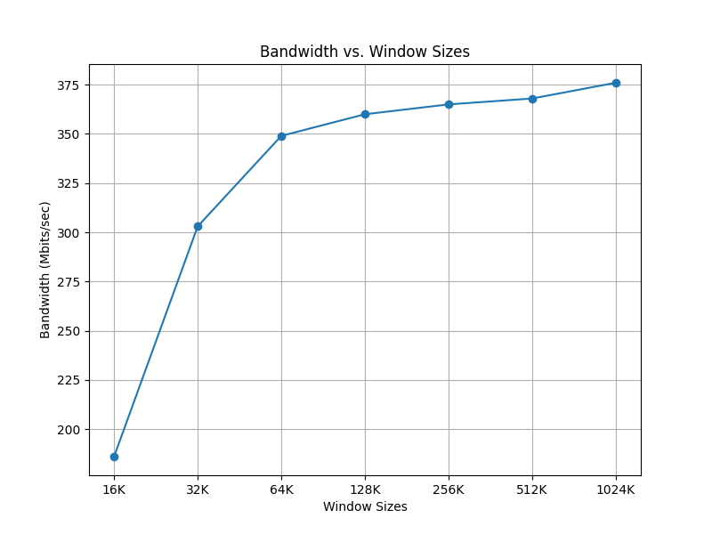
Bandwidth vs TCP window size
The bandwidth increases with the window size increase
Explain:
Increasing the TCP window size to half means the sender can send more unacknowledged packets before pausing, resulting in a higher data transmission rate and increased bandwidth.
On the contrary, smaller window sizes lead to increased acknowledgment overhead and less efficient network capacity utilization, causing a decrease in bandwidth.

Slide 5
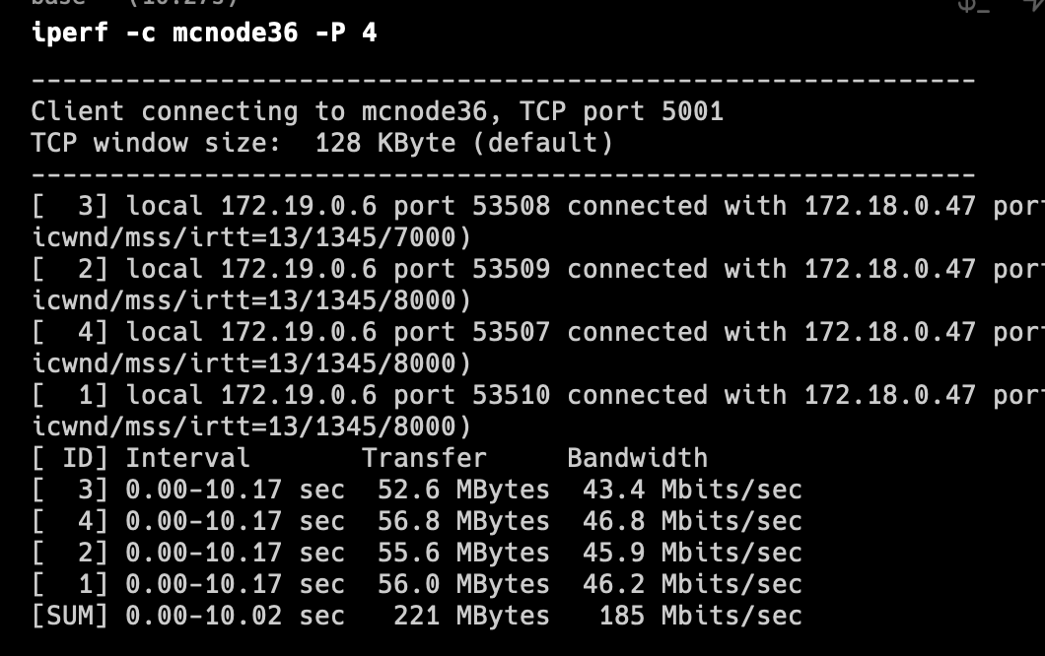
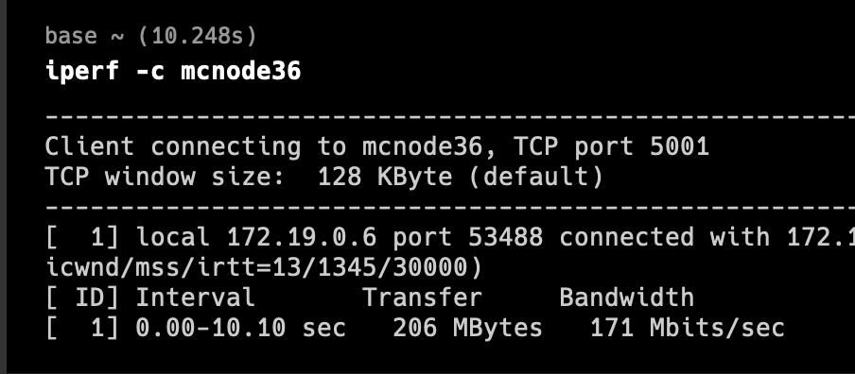
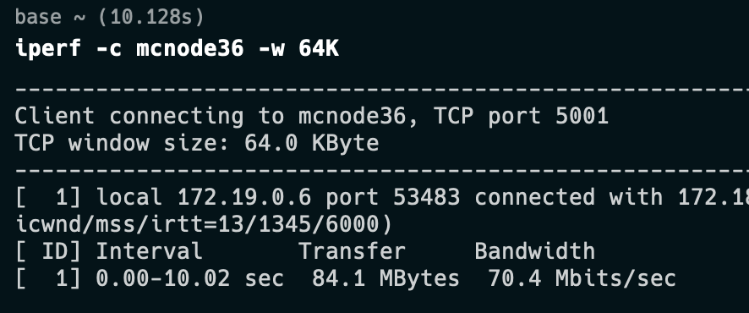
Wireless（ WiFi）
Wired networks use physical cables, providing stable and interference-free communication, while wireless networks rely on radio waves, which are susceptible to interference and signal degradation.
Shared wireless channels, signal attenuation over distance, and half-duplex communication further limit wireless bandwidth.

Slide 6
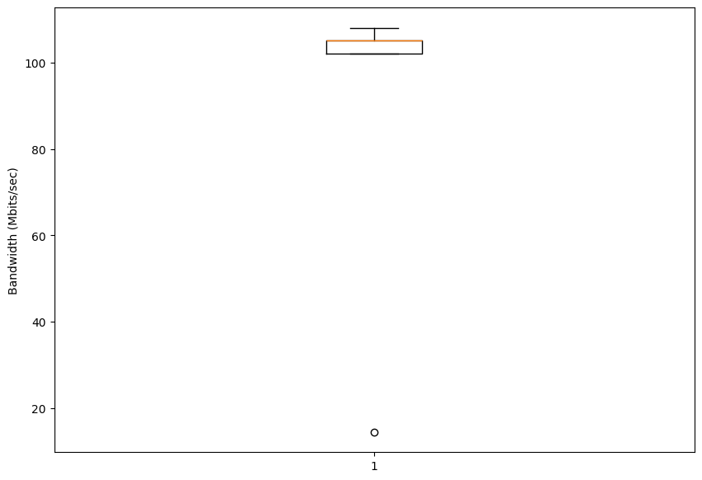
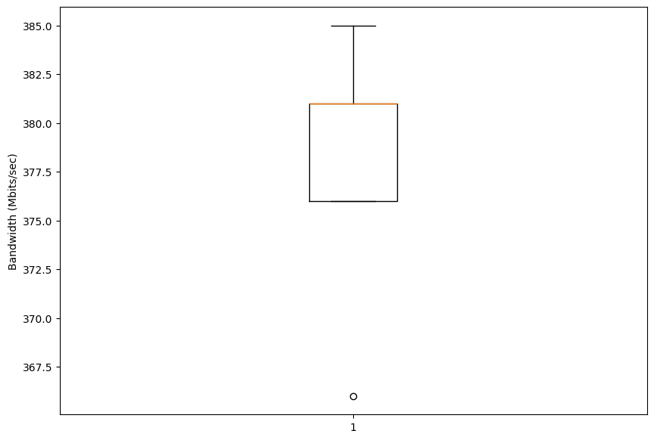
Different Location
The different server has different bandwidth
USA
KAUST

Slide 7
Delay vs link rate
Mb/s
Because LA server is far away from KAUST. So the delay is much larger.
ms
hop

Slide 8
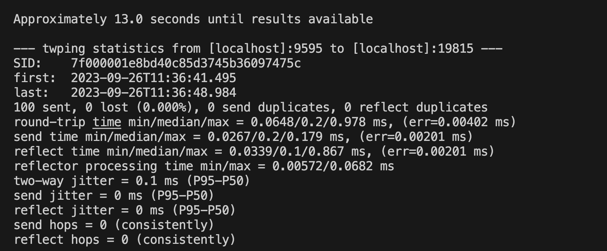
Twping localhost

